Slide 1
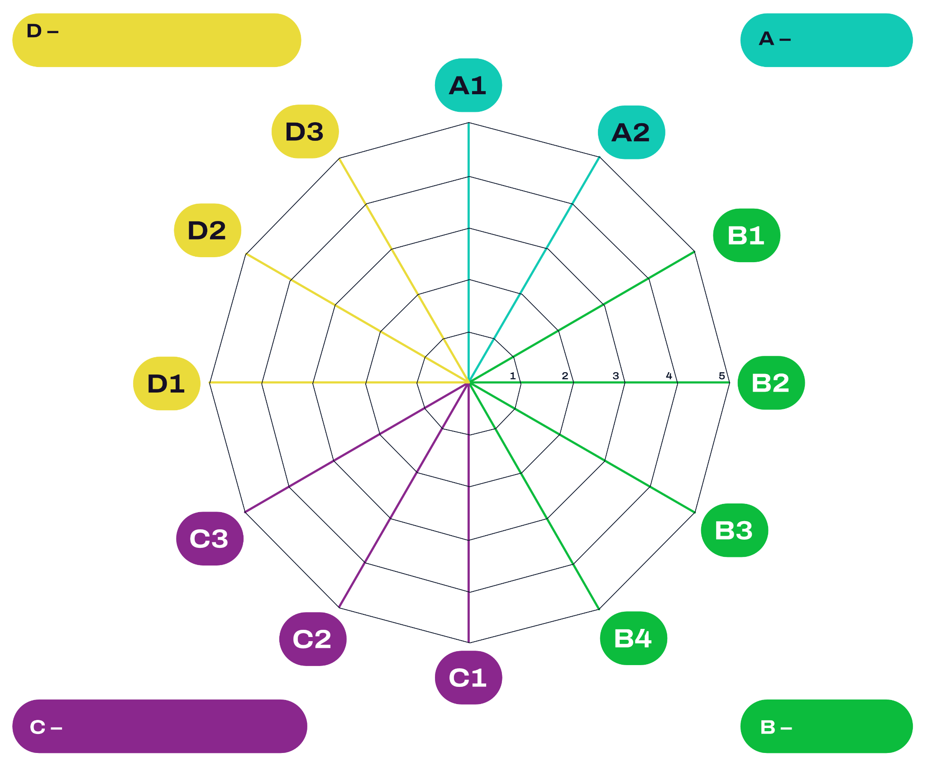

Date
Organisation, Agility and Innovation
You can click on each term to edit it and translate it into another language.
Community, Culture,
and Communication
Empowering
Change Through
Artistic Work
Print these 2 pages on A3 sheets each and then put them together to get a A2 sheet of paper.
Community
Building and
Place-Making
Internal
Culture and
Communication
Qualification
and Training
Funded by the European Union. Views and opinions expressed are however those of the author(s) only and do not necessarily reflect those of the European Union or the European Education and Culture Executive Agency (EACEA). Neither the European Union nor EACEA can be held responsible for them.
Occupational
Health and Safety
Social Responsibility
Employment and Work Organisation

Slide 2

Organisation, Agility and Innovation
You can click on each term to edit it and translate it into another language.
Economy
Economic Situation
Print these 2 pages on A3 sheets each and then put them together to get a A2 sheet of paper.
Sustainability Mindset and Motivation
Implementation
of Sustainability
Strategies
Institutional Environ- mental Protection and Resilience
Environmentally
Friendly Production
Design and Circularity
Employment and Work Organisation
Ecology

